Slide 1
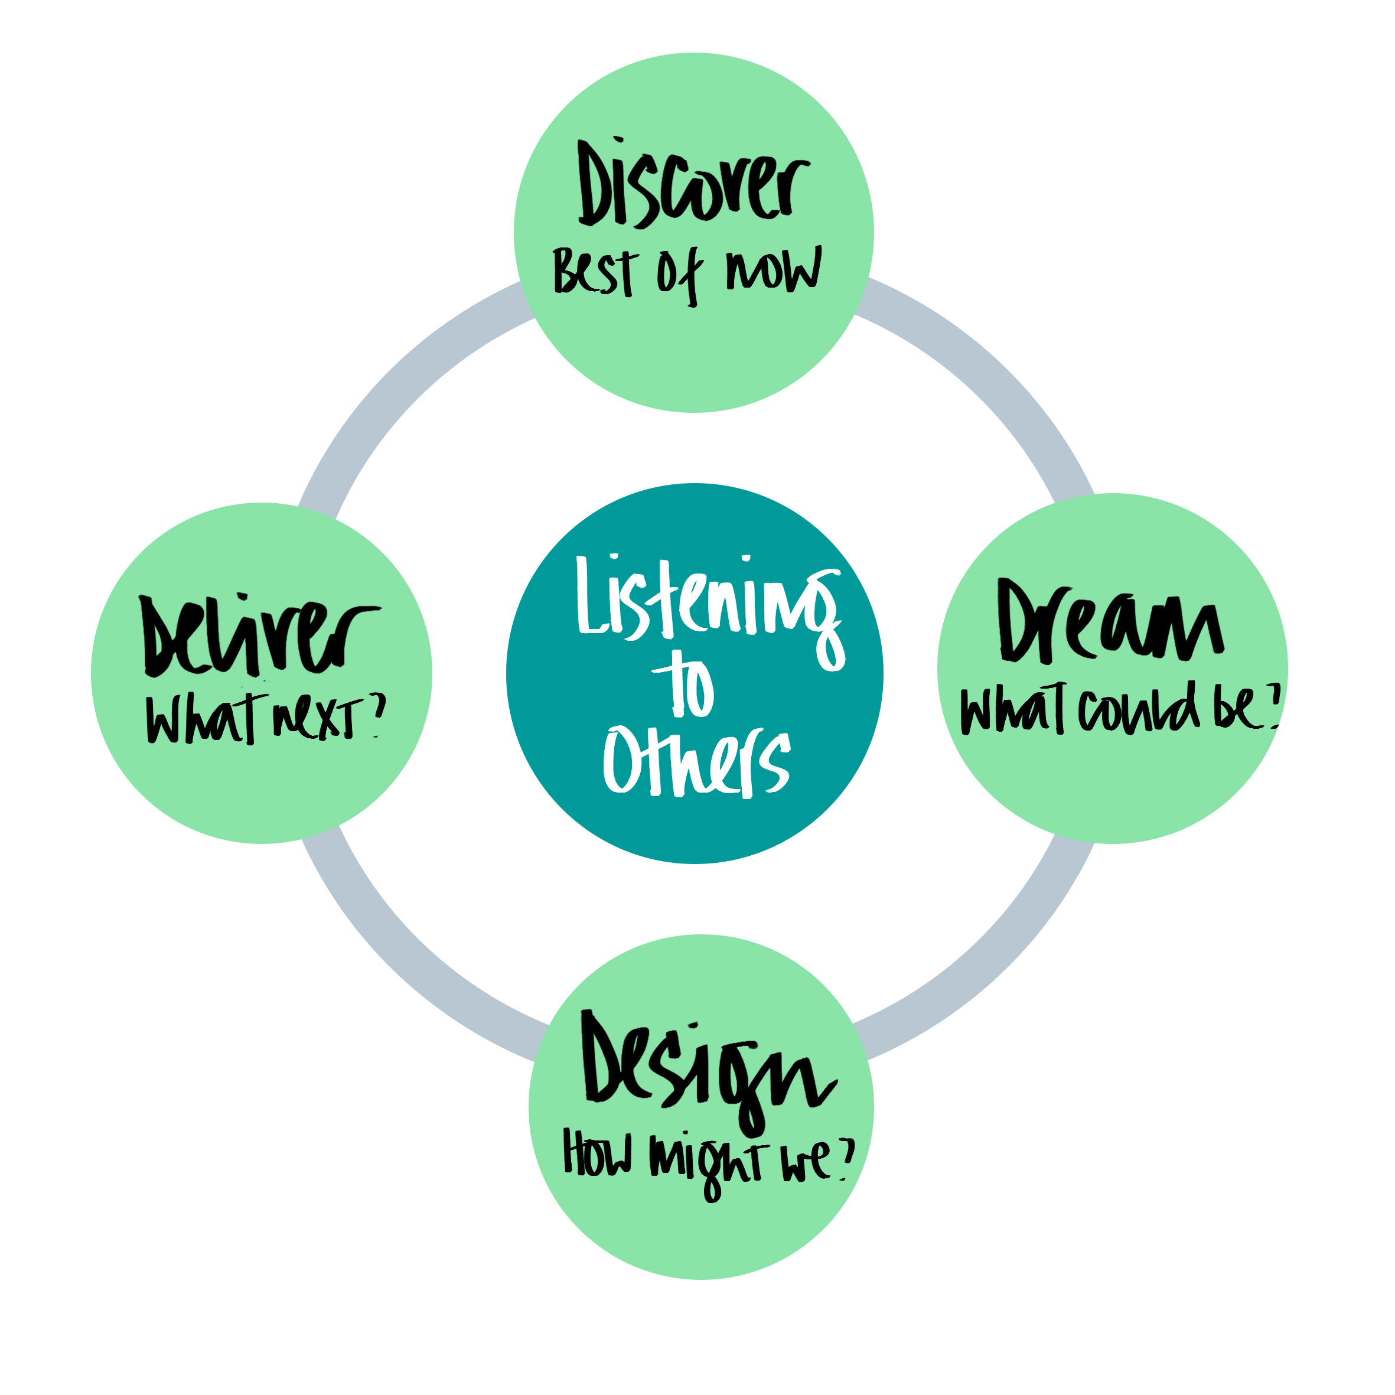
List your 5 signature strengths:
Share how your strengths create positive performance in your current role.
Share how your strengths create positive relationships in your current role.
Actions to implement this plan – individual:
I would like to see more use of your strengths in these areas:
What are your hopes and ambitions for the future?
Describe your most important development goal for the next 6 months.
Actions to implement this plan – line manager:
Ideas for change and
development
I believe your most important development goal is:

